Slide 1
Snake Game
Name | Roll Number
Ali Ahmed | 21B-085-SE
Khadeejah Ashraf | 21B-037-SE
Alishba Ahmed | 21B-208-SE
Aqsa | 21B-198-SE

Slide 2
1. Introduction
Project Topic: Snake Game Implementation with Java Swing
Significance: The Snake game is a classic and popular arcade game that entertains users of all ages. Our project aims to implement this game using Java Swing, offering a nostalgic yet interactive gaming experience.
Objectives and Scope:
Implementing a functional Snake game with intuitive controls.
Providing an engaging user interface using Java Swing.
Enhancing gameplay experience with features like score tracking, cherry pickups, and dynamic speed adjustment.

Slide 3
2. Problem Statement
Problem Description :
Lack of a simple, classic Snake game implementation using Java Swing.
Many existing implementations lack features or are overly complex.
Importance of Solving This Problem:
Recreation of classic games provides entertainment and nostalgia.
Offers a learning opportunity for Java Swing enthusiasts.

Slide 4
3. Solution Overview
Overview of the Solution:
How the Solution Addresses the Problem:
Implementation of the classic Snake game using Java Swing GUI.
Features intuitive controls and dyamic gameplay elements.
Provides an enjoyable gaming experience for users.
Provides a simple yet feature-rich Snake game implementation using Java Swing.
Offers an interactive and nostalgic gaming experience for users of all ages.

Slide 5
4. Key Features
Main Features and Functionalities:
Classic Gameplay: Replicates the classic Snake game experience.
Score Tracking: Keeps track of player's score and best score.
Cherry Pickups: Cherry pickups to increase score and adjust game speed.
Dynamic Speed Adjustment: Game speed adjusts based on player's performance.
Pause and Resume: Allows pausing and resuming the game.
Game Over Animation: Provides visual cues on game over with animation.

Slide 6
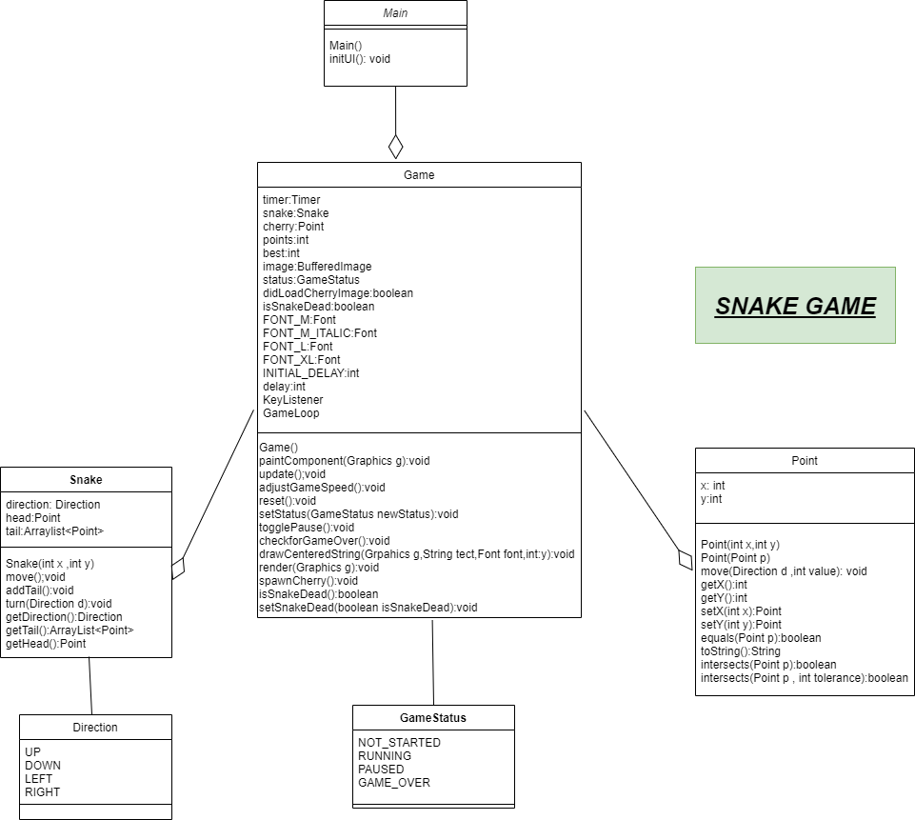
5. Architecture

Slide 7
5. Technologies (Contin..)
Technologies:
Java Swing for GUI development.
Java's Timer for game loop implementation.
BufferedImage for loading game images.

Slide 8
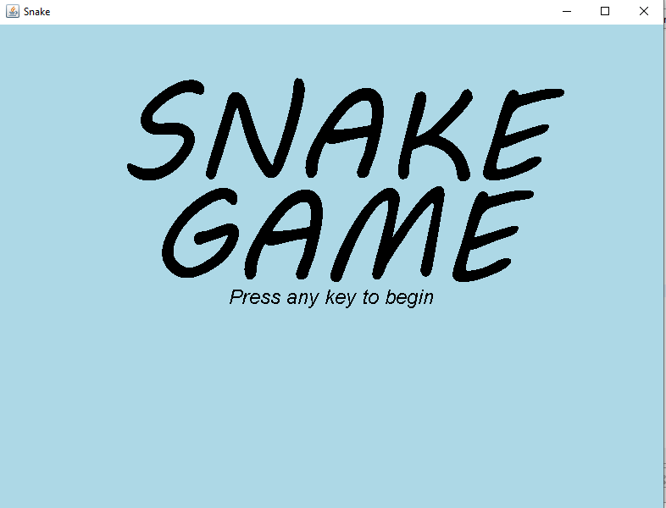
6. Demo

Slide 9
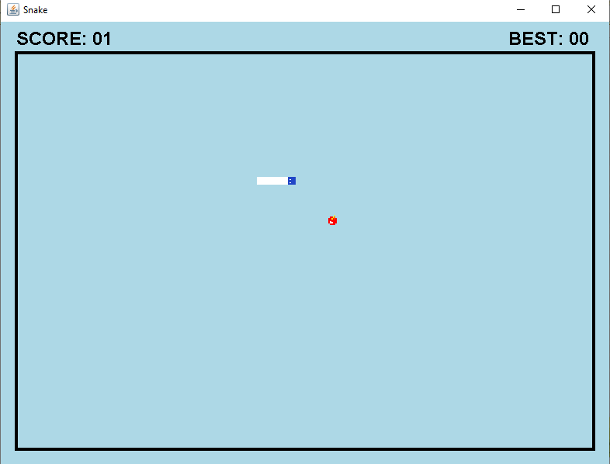
6. Demo (Contin..)

Slide 10
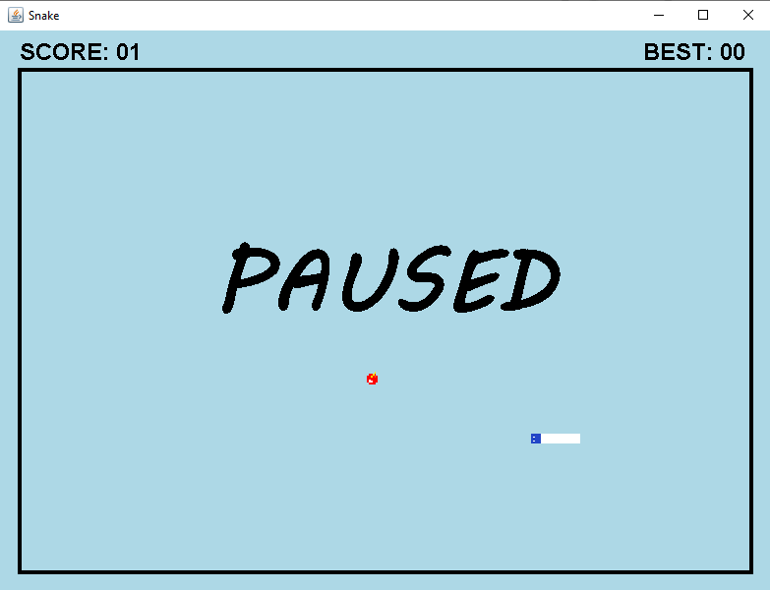
6. Demo (Contin..)

Slide 11
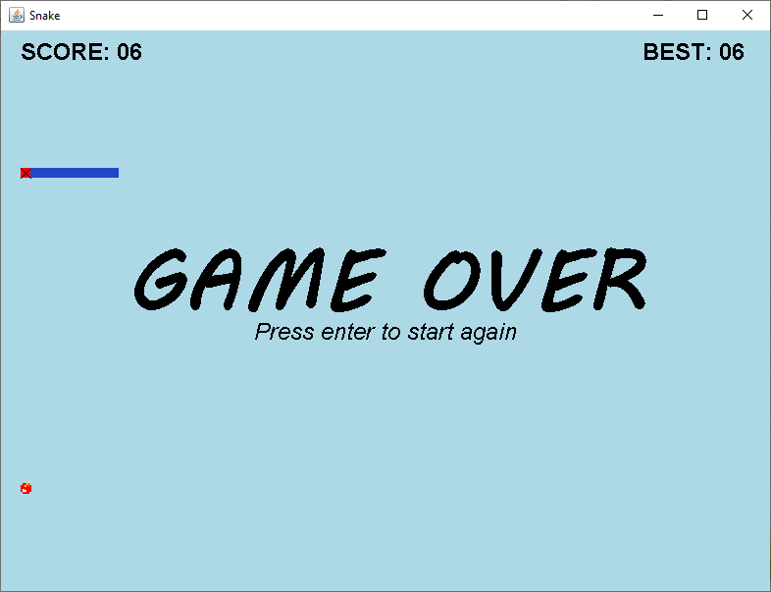
6. Demo (Contin..)

Slide 12
7. Achievements & Results
Outcomes:
Achievements:
Successfully implemented a fully functional Snake game using Java Swing.
Provided an engaging user experience with intuitive controls and dynamic gameplay.
Positive feedback from users.
Smooth and bug-free gameplay experience.

Slide 13
8. Future Enhancements
Multiplayer Support: Implement multiplayer mode.
More Power-Ups: Add different types of power-ups.
Customization Options: Allow customization of snake appearance.
Sound Effects: Incorporate sound effects for better immersion.
High Scores: Implement a high score leaderboard.

Slide 14
9. Conclusion
Summary:
Significance and Impact:
Offers entertainment and learning opportunities for users.
Demonstrates the capabilities of Java Swing in game development.
Developed a classic Snake game implementation using Java Swing.
Achieved the objectives of providing an interactive and nostalgic gaming experience.

Slide 15
Thank You!

